Slide 1
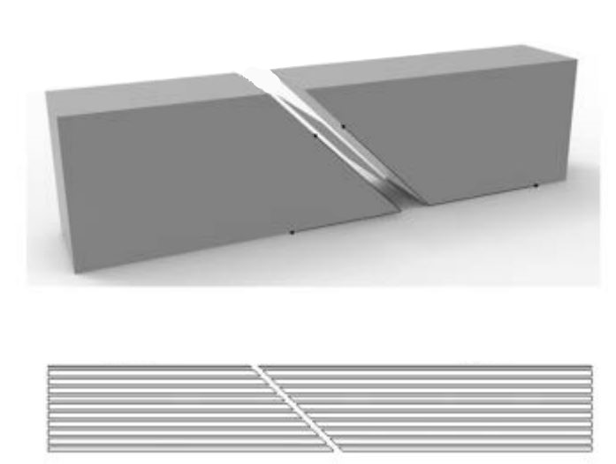
Chunking Plane
Chunk 2
Chunk 1
Chunk 1
Chunk 2

